Slide 1





Programming with
Alireza Soltani Khaboushan
MD-MPH
Pediatric Urology and Regenerative Medicine Research Center
Tehran University of Medical Sciences

Slide 2
Me = { "Name" : "Alireza Soltani", "Age" : 22, "Education" : [
"MD student at TUMS",
"Cardiology Research Diploma at THC",
"MPH student at TUMS"
], ”Roles" : [
"Research Assistant at PURMRC",
"Structural Editor at JOST”,
"Referee at SSRC Research Council”
], "Interests" : [
"Neurology",
"Regenerative Medicine",
"Programming",
"Statistics",
"Artificial Intelligence"
], "Skills" : [
# There’s always room for improvement:)
],
"E-mail" : "alirezasoltanykhaboshan@gmail.com",
”LinkedIn" : "https://www.linkedin.com/in/alireza-soltani-709848255/",
”ResearchGate" : "https://www.researchgate.net/profile/Alireza-Soltani-Khaboushan",
}
Then, R you familiar with R?

Slide 3
TABLE OF CONTENTS
01
03
02
04
Descriptive Statistics and Visualization
Why R??
Basics of Coding with R
Inferential Statistics

Slide 4
01
Why R?

Slide 5
R was developed by Ross Ihaka and Robert Gentleman at the University of Auckland, New Zealand, in the mid-1990s, and is now maintained by the R Development Core Team.
The initial version of R was released in 1995, and it was modeled after the S language, which was developed at Bell Laboratories by John Chambers and his colleagues.
R has a wide range of functionalities for statistical analysis, data visualization, and data manipulation.
It is widely used in both academia and industry, particularly in fields such as data science, finance, and biostatistics.

Slide 6







WHY R? Is it still worth learning R? Can R be replaced by python? Is it a dying language? R vs Stata vs MATLAB?

Slide 7

Pros
Free
Open-Source
Visualization
Multiple Cutting-Edge Statistical Packages
Data Handling and Manipulation
Meta-Analysis
Integrated Development Environment
Help Reproducible Research
Shiny, dplyr, and ggplot2

Slide 8
Cons
Not Optimized Usage of Memory
Indexing Starts from One Instead of Zero
Inconsistent Packages and Syntaxes
Could Get Dreadfully Slow
Better Alternatives Available for Deep Learning
Not the Best Option for Object-Oriented Programming

Slide 9
Download and Install R and Rstudio
CRAN
Rstudio
Download and install
Download and install
https://cran.rstudio.com/
https://posit.co/download/rstudio-desktop/
Choose your OS and install R
Choose your OS and install RStudio

Slide 10


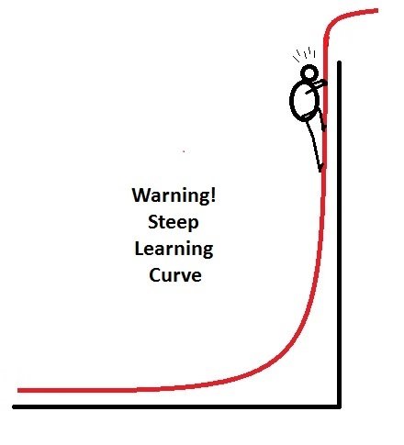
Learning R

Slide 11
02
Basics of Coding with R

Slide 12
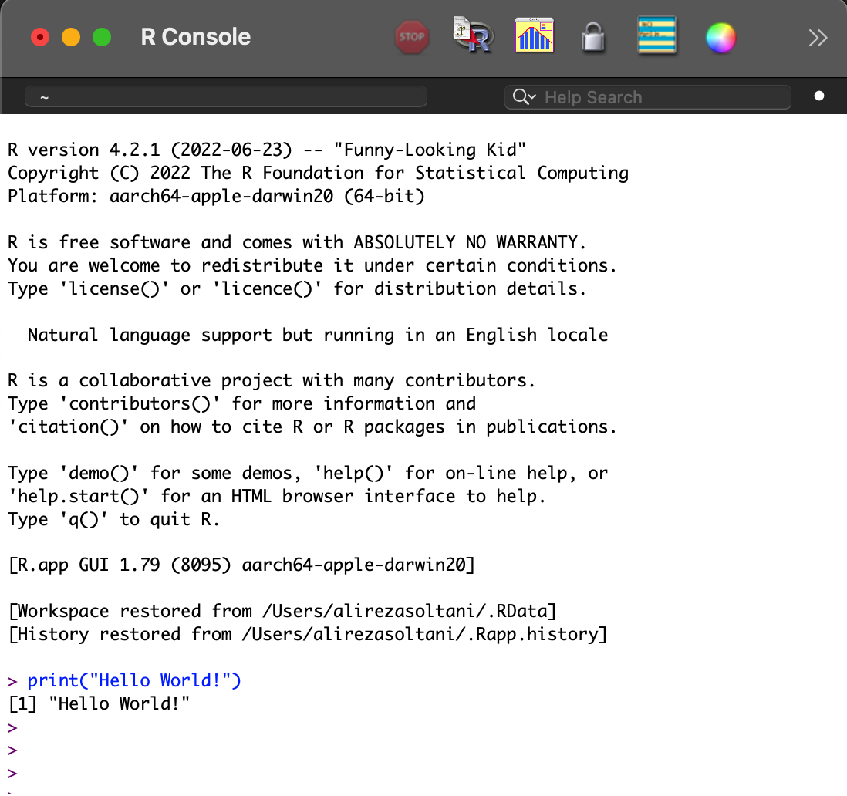

Slide 13
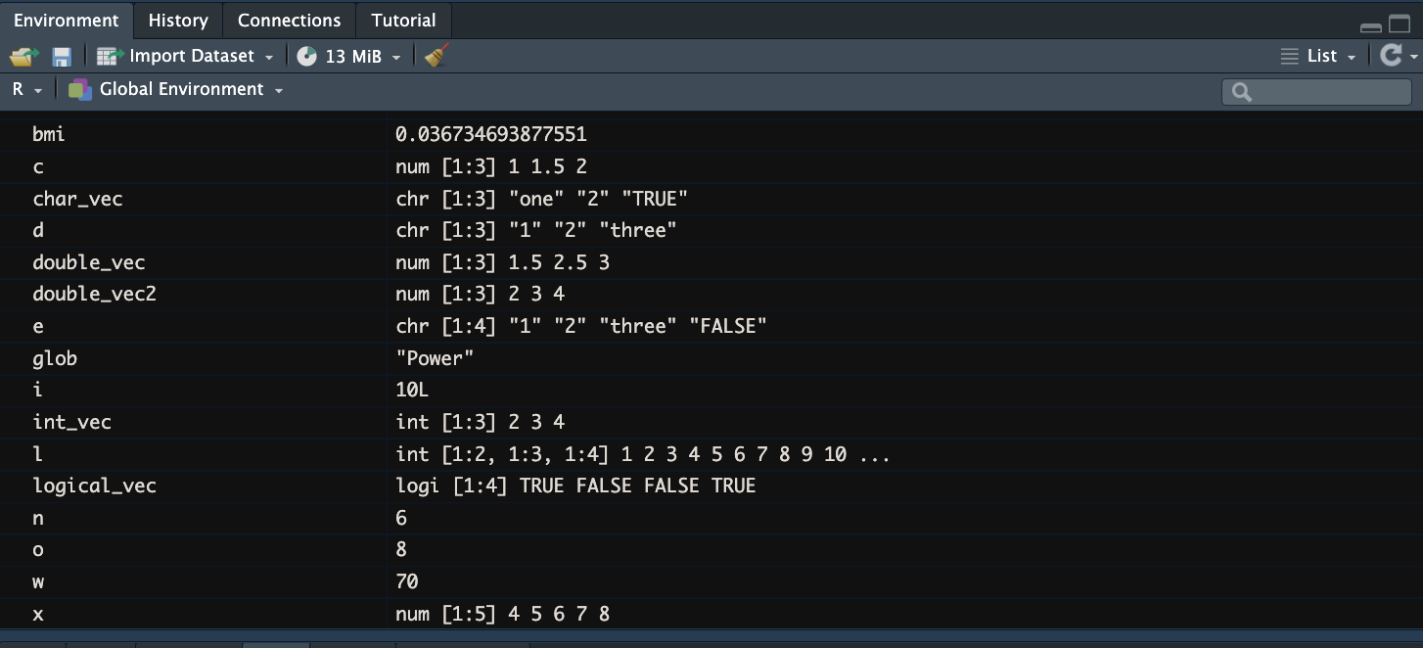
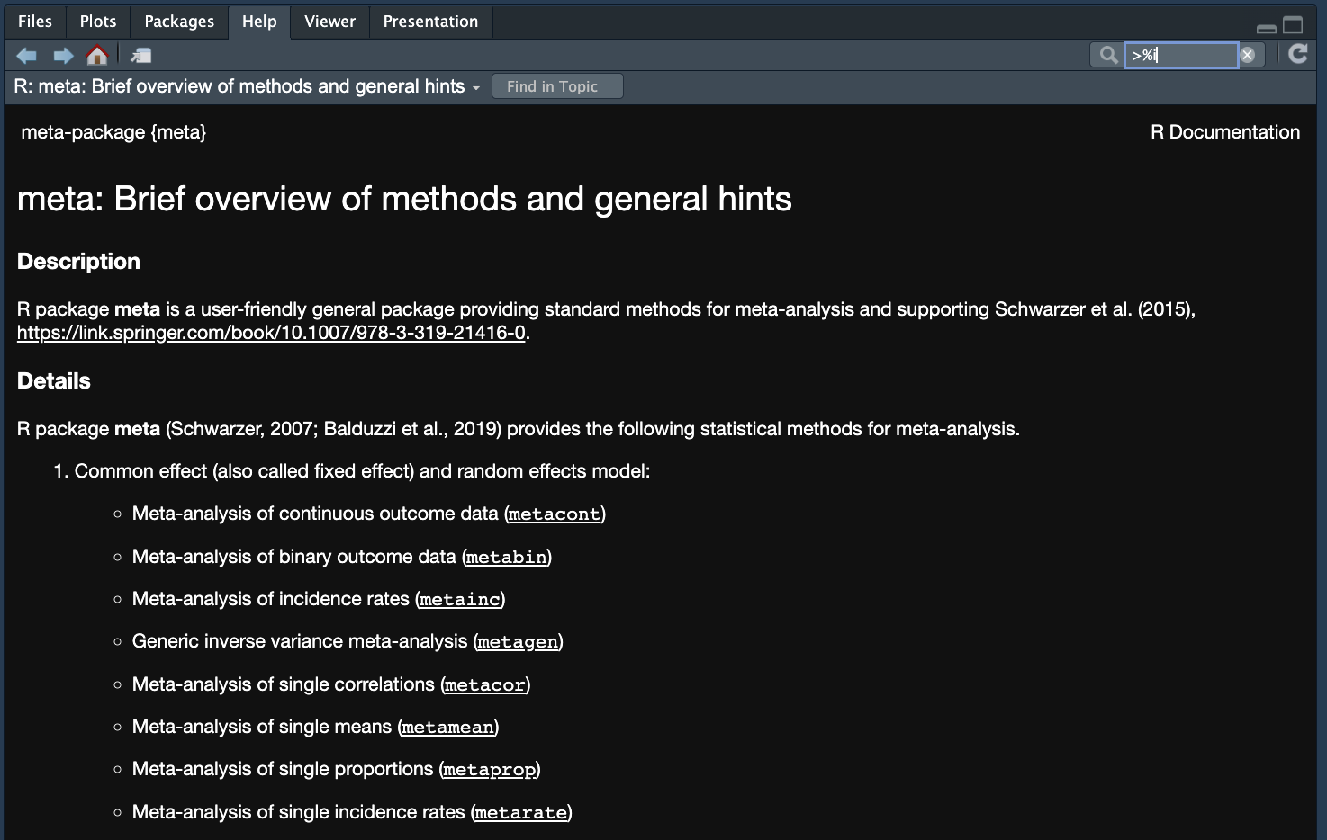
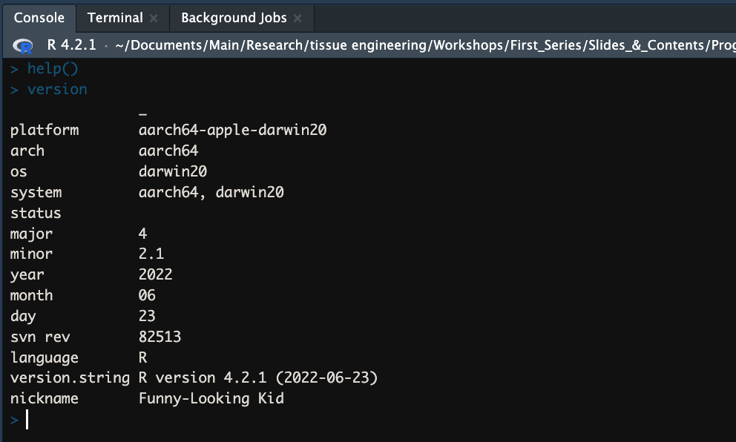
Environment
Outputs, packages, etc.
Environment
Console

Slide 14
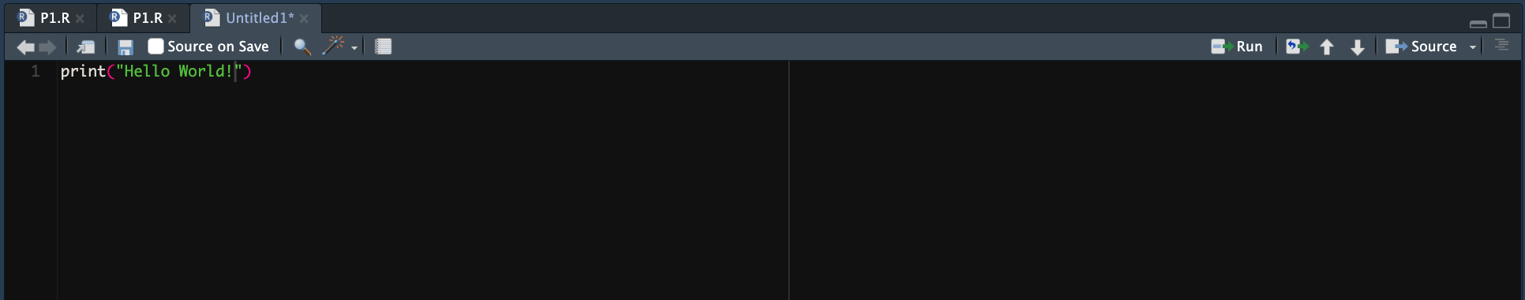
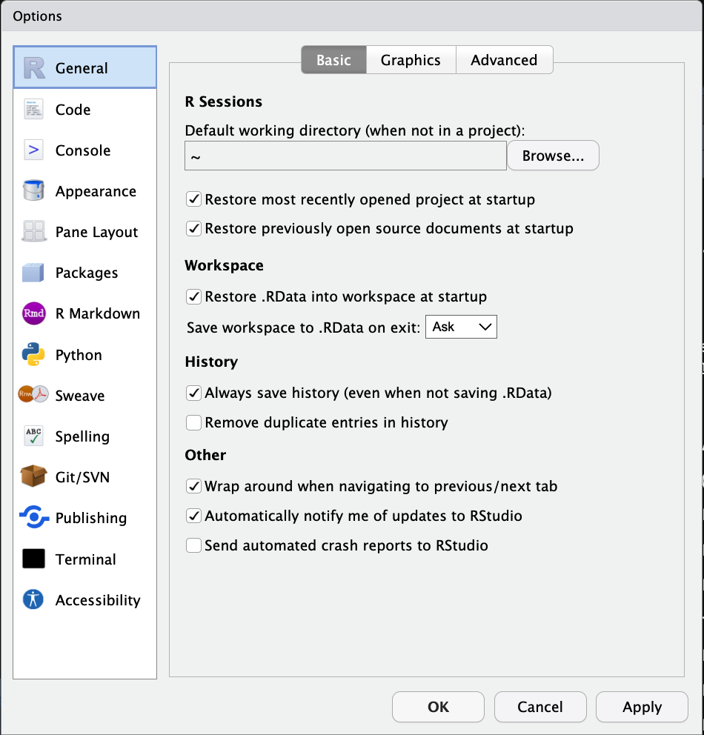

Slide 15
Getting Started with R
> print(“Hello World!”)
[1] Hello World!
Arithmetic Operations
+ Addition
- Subtraction
* Multiplication
/ Division
^ Power
%% Remainder
%/% Quotient
%*% Matrix Multiplication
sqrt() Square Root
abs() Absolute Value

Slide 16
Operator Syntax and Precedence
:: ::: | access variables in a namespace
$ @ | component / slot extraction
[ [[ | indexing
! | negation
& && | and (bit-wise and Boolean, respectively)
| || | or (bit-wise and Boolean, respectively)
~ | as in formulae
-> ->> | rightwards assignment
<- <<- | assignment (right to left)
= | assignment (right to left)
? | help (unary and binary)
%>% | pipe
%in% | value matching

Slide 17
> 5 + 2
[1] 7
> 5 - 2
[1] 3
> 5 * 2
[1] 10
> 5 / 2
[1] 2.5
> 5 ^ 2
[1] 25
> 5 %% 2
[1] 1
> 5 %/% 2
[1] 2
> sqrt(9)
[1] 3
> abs(-9)
[1] 9

Slide 18
Assignment
To assign value to variable use <- instead of =
> h <- 180
> w <- 70
> h
[1] 180
> w
[1] 70
To assign arguments in the function use =
> rnorm(n = 2, mean = 5, sd = 2)
[1] 2.567296 5.100900

Slide 19
Example
Calculate BMI

Slide 20
Variables and Data Types
Variable stores specific data which could be in various forms:
Integer 5:100, 5L
Double 5.0, 5, c(1, 2, 3, 4)
Logical True, T, False, F
Character “True”, “Name”
List list(1, 2, 3)
Function a <- fun(x) {mean(1:x)}
Raw raw(2)
Complex 2+0i
Check the type of variables using typeof() function

Slide 21
Variables and Data Types
A variable name must start with a letter and can be a combination of letters, digits, period(.), and underscore(_).
If it starts with period(.), it cannot be followed by a digit.
A variable name cannot start with a number or underscore (_).
Variable names are case-sensitive (age, Age and AGE are three different variables).
Reserved words cannot be used as variables (TRUE, FALSE, NULL, if...).
Variables name are snake_case in R.

Slide 22
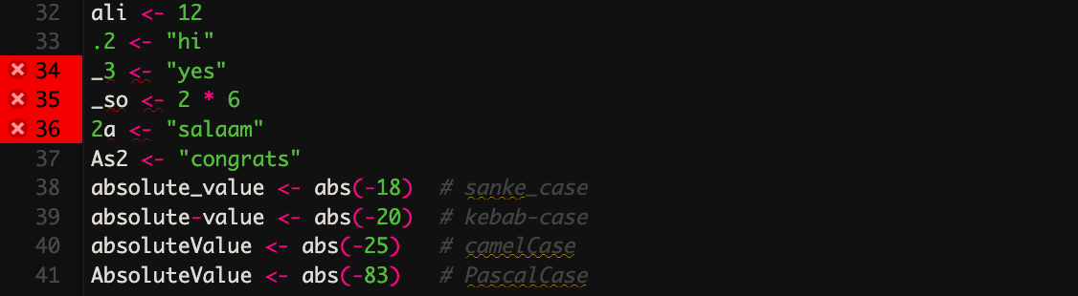

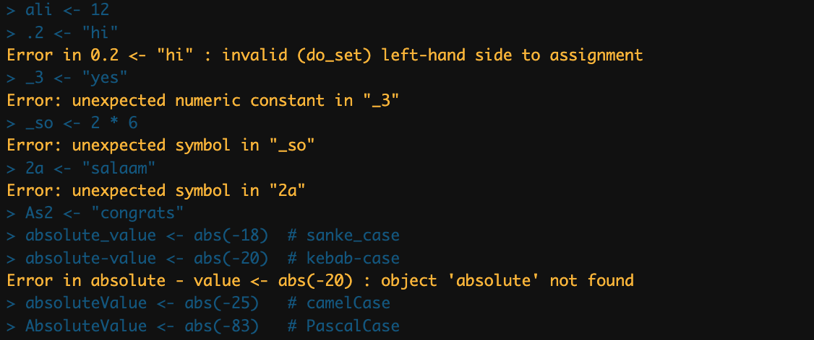
Example

Slide 23
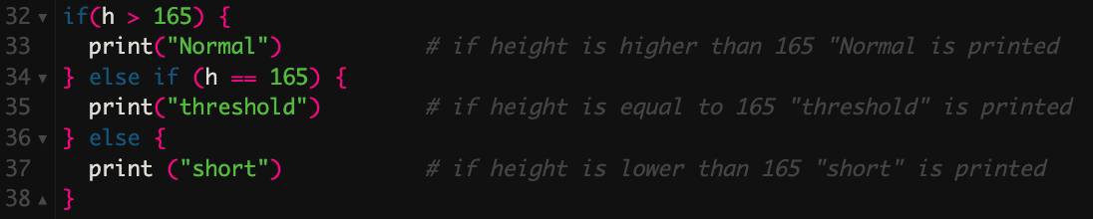
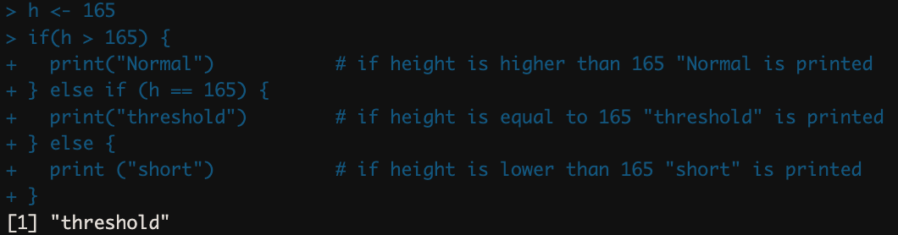
Conditionals
If, else if, and else are used for conditional statements
# is used to add comments to the code
Comments will help the readability and reproducibility of the code

Slide 24
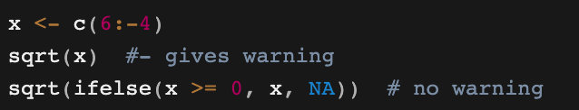
ifelse()
A handy-dandy function help with applying conditions on vectors, lists, data frames
It prevents using excessive for loop and speeds up the code

Slide 25
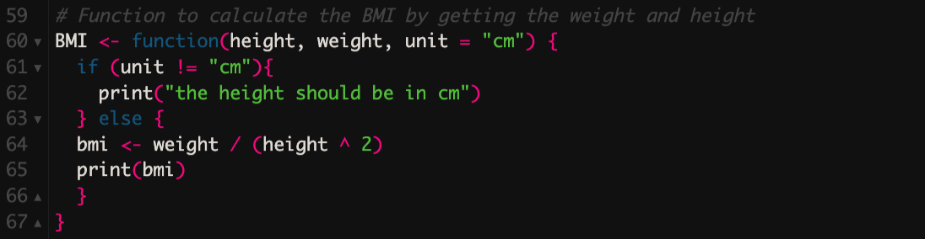
Functions
Functions hugely help to do a work repeatedly
Calling Functions
Default Arguments
Global variables
Nested Functions
Recursive functions
Notes:
There are some bult-in functions could be directly called from base R
However to access further functions it is needed to new packages being installed or new function being defined

Slide 26
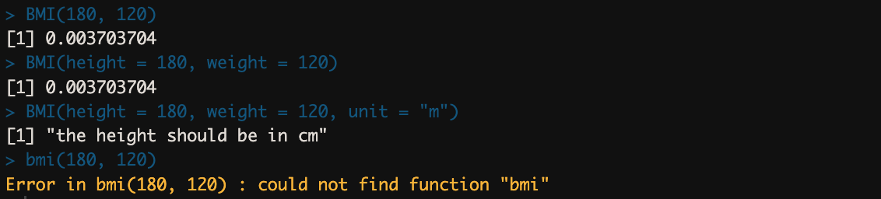
Example
Calling Functions and Default Arguments

Slide 27
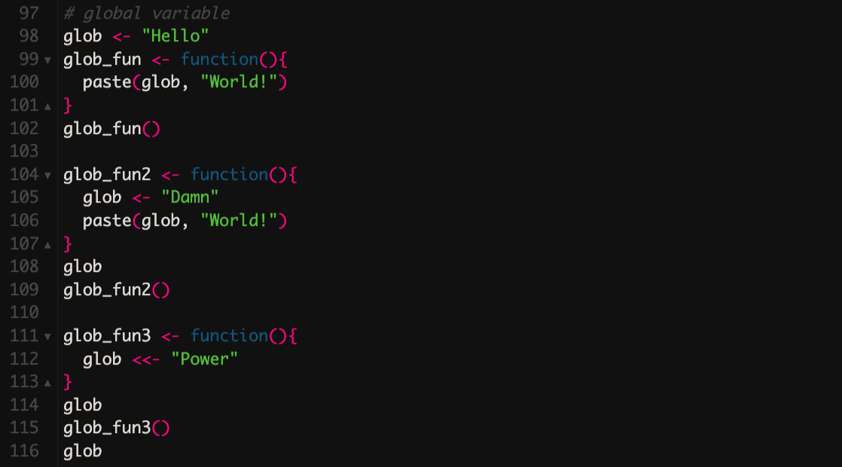
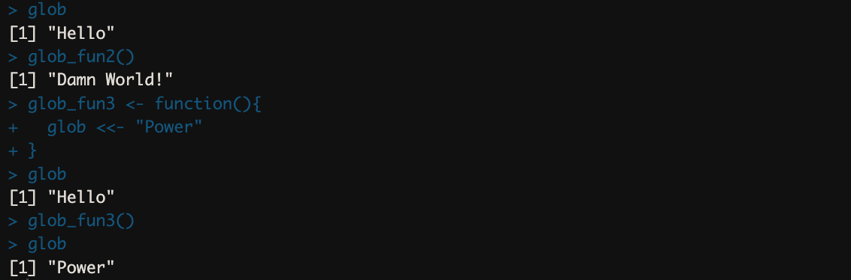
Example
Global Variables

Slide 28
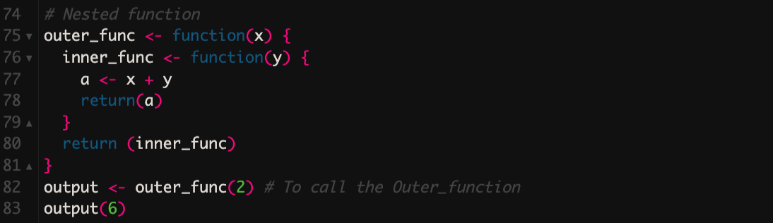
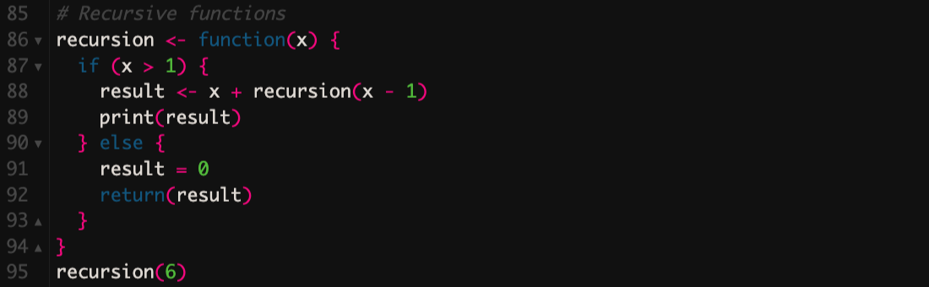
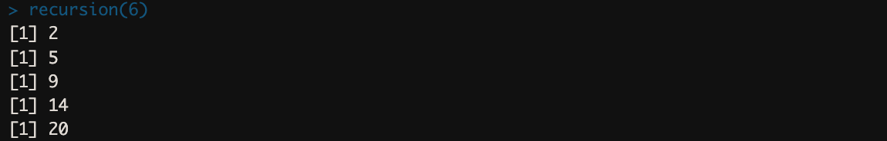
Example
Nested Function
Recursive Function

Slide 29
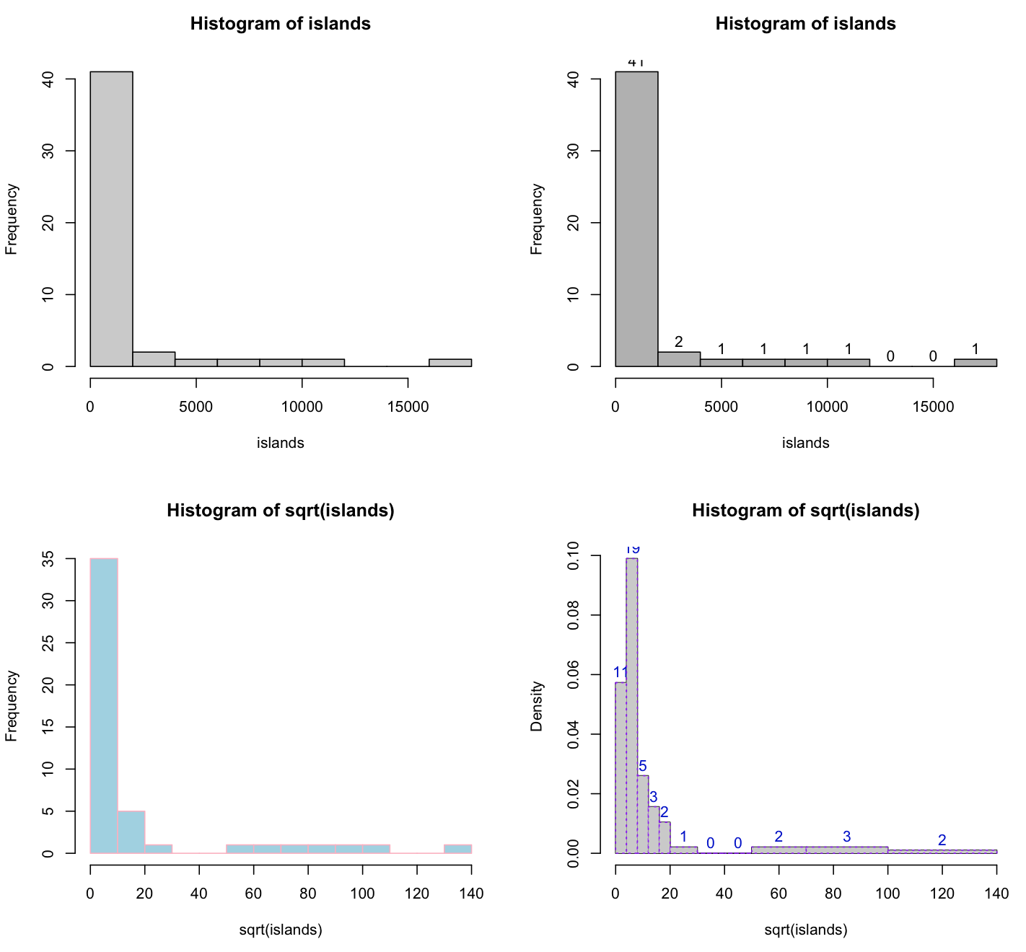
help(“package”)
To have a description about the package and its application
example(“hist”)

Slide 30
Loops (For Loops)
“For Loops” are used for repetitious doing of a task
For (iterator in list or vector) {
statement
}
For loop could be combined with conditionals
With the next statement, we can skip an iteration without terminating the loop
With the break statement, we can stop the loop before it has looped through all the items
A for loop could be inside another for loop as nested for loop

Slide 31
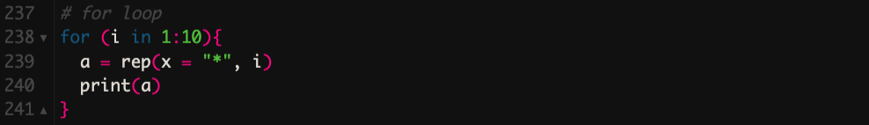
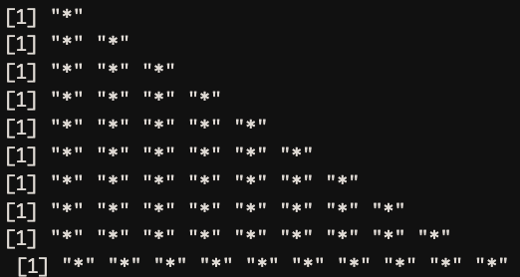
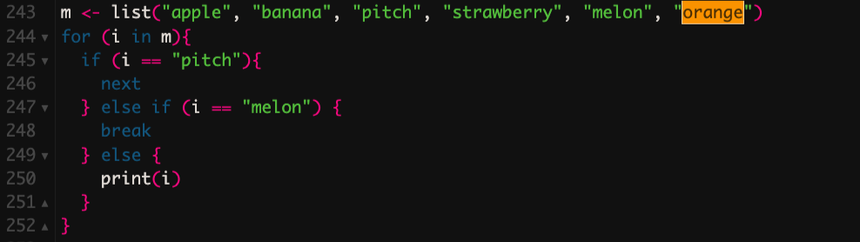
Example
For loop
For loop and conditionals

Slide 32
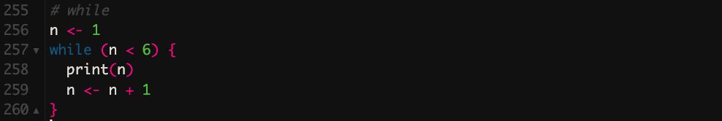
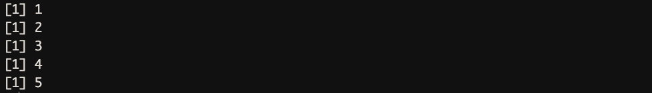
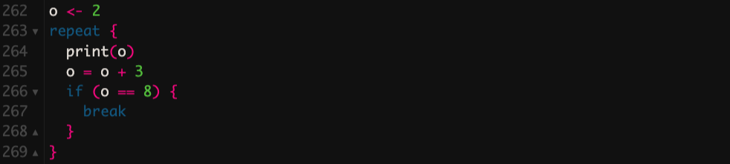
While
With the while loop we can execute a set of statements as long as a condition is TRUE
Repeat loop in R is used to iterate over a block of code multiple number of times. And also it executes the same code again and again until a break statement is found.

Slide 33
Data Structures
 | Homogenous | Heterogenous
1-Dimensional | Vector | List
2-Dimensional | Matrix | Data Frame
n-Dimensional | Array

Slide 34
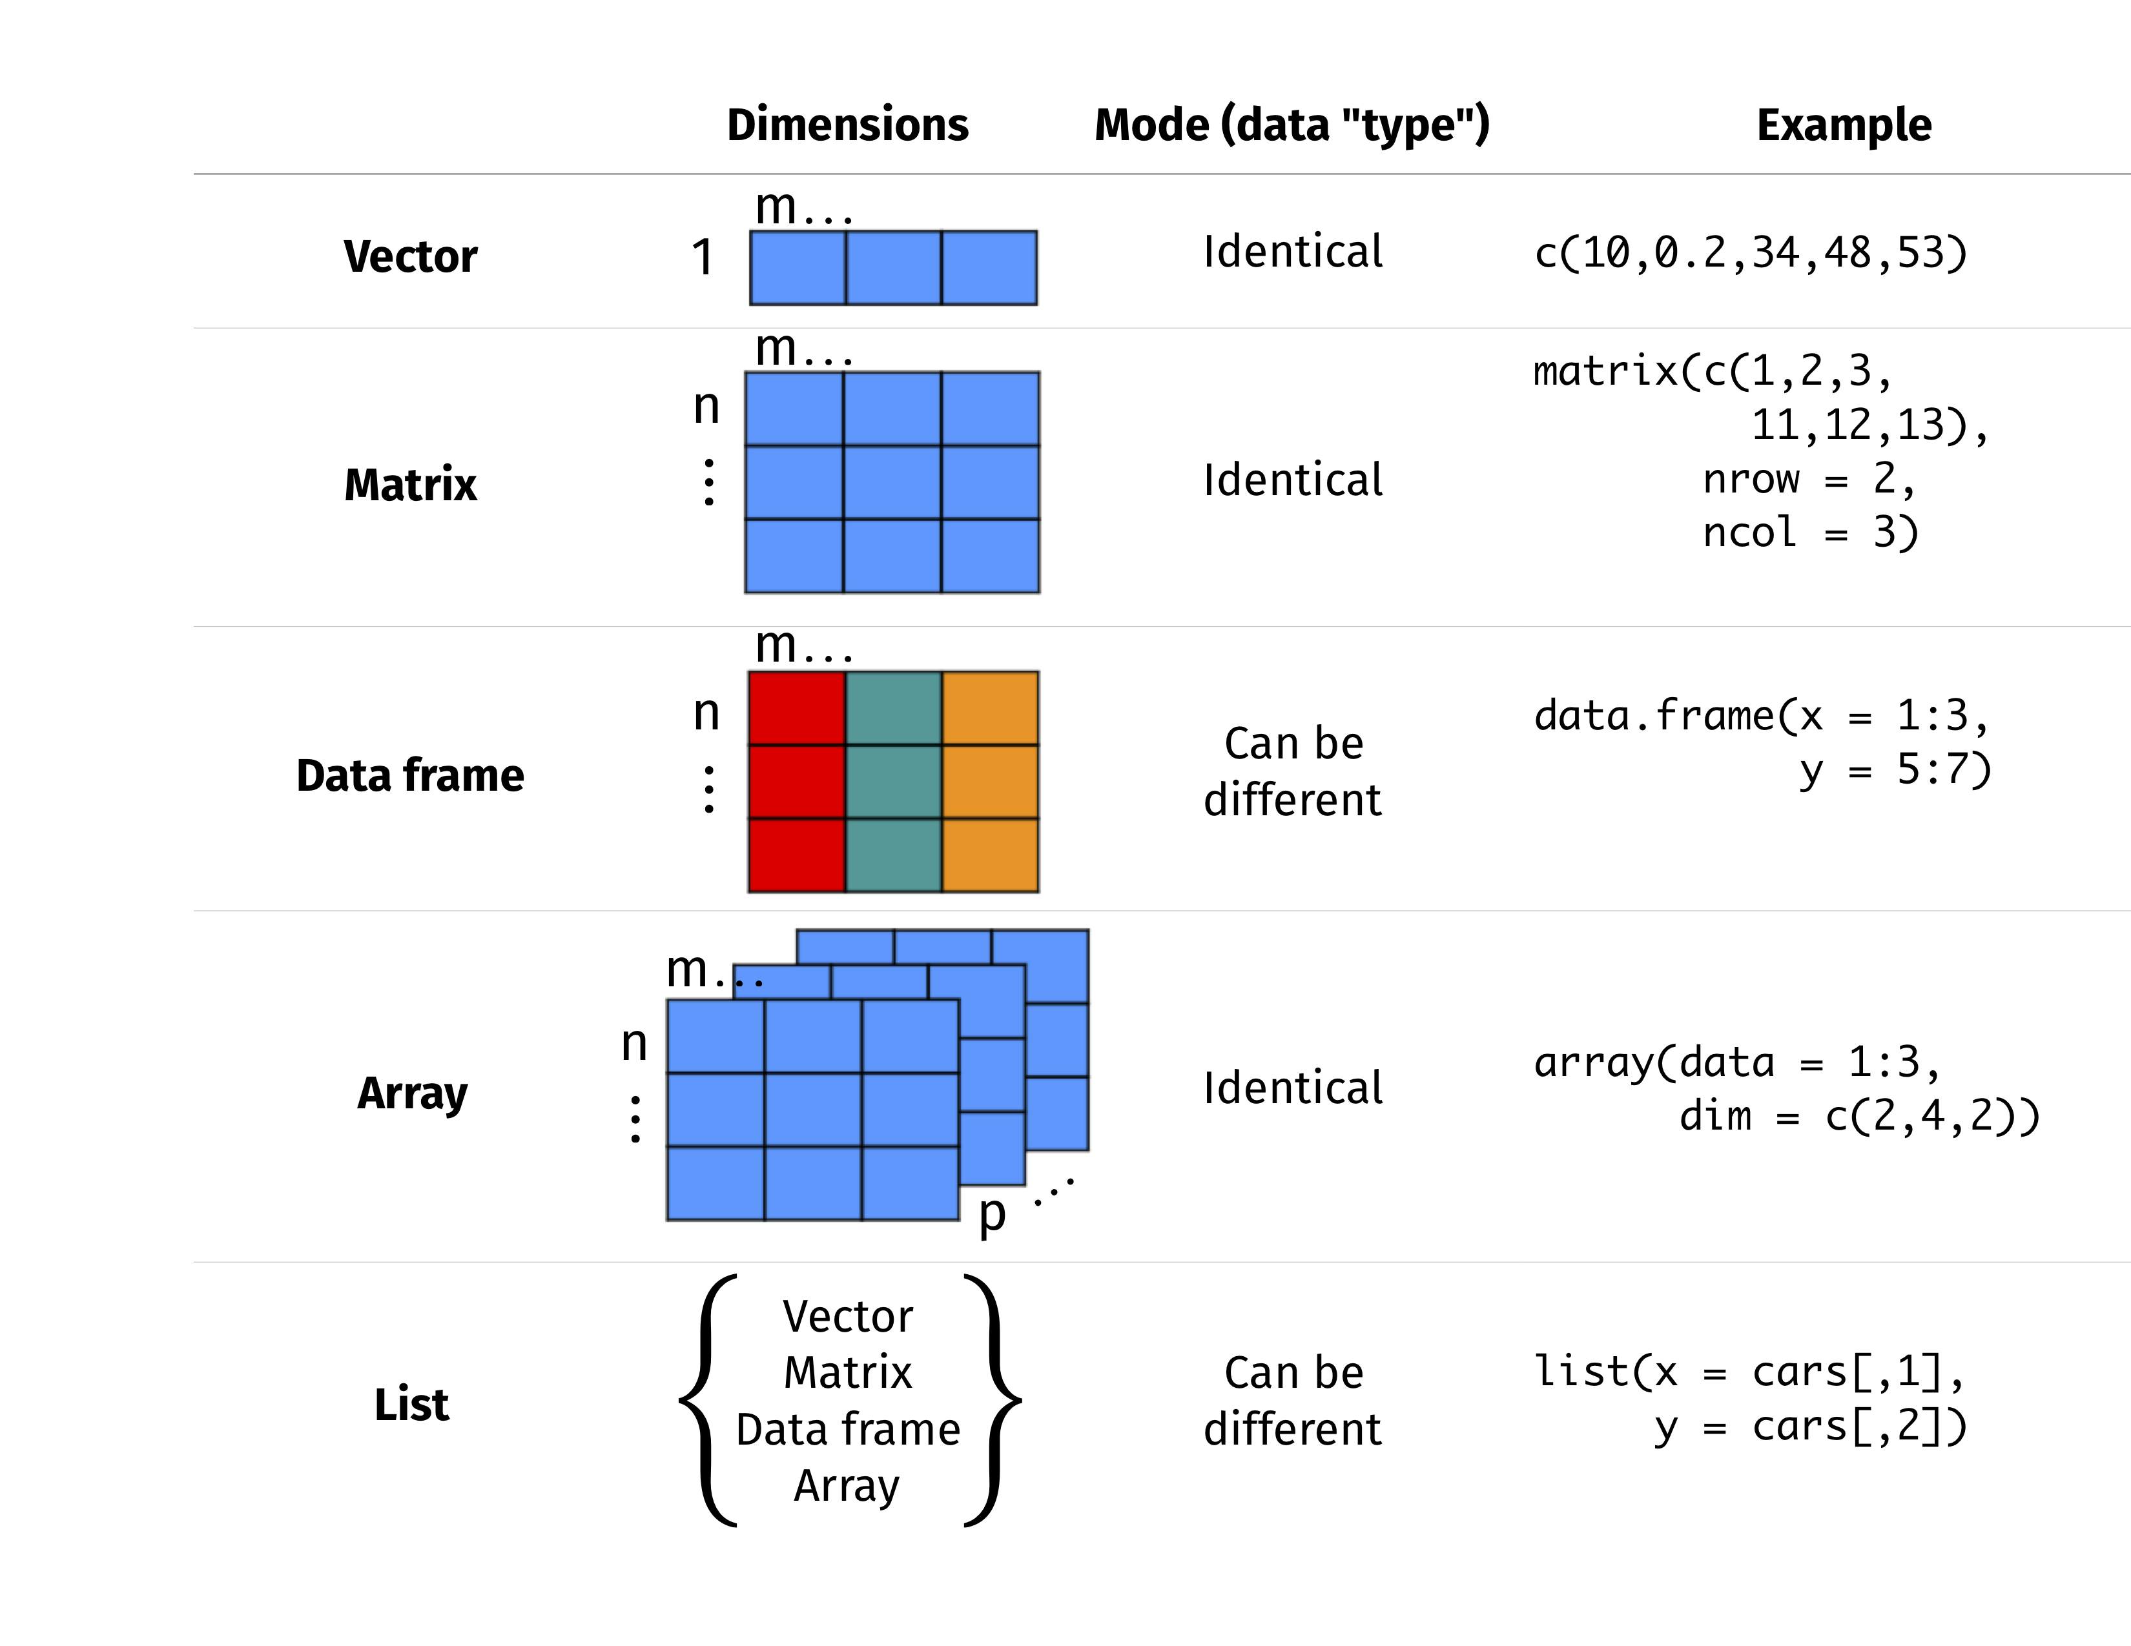

Slide 35
Some practical functions for interrogating data structure in R
str()
class()
typeof()
summary()
attributes()
names()
dim()
length()
nrow()
ncol()
colnames()
…

Slide 36
Str() vs class() vs typeof()
In summary, str provides a detailed summary of an object's structure, class returns the class of an object which defines its type, and typeof returns the basic data type of an object.

Slide 37
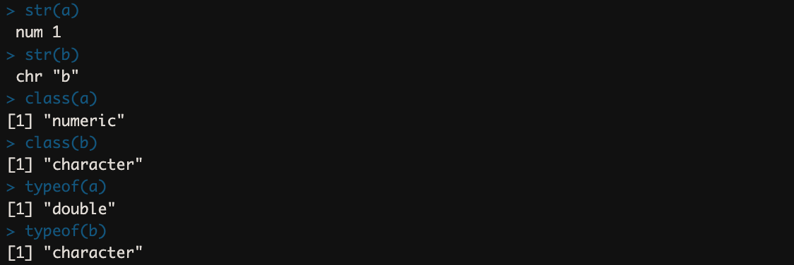
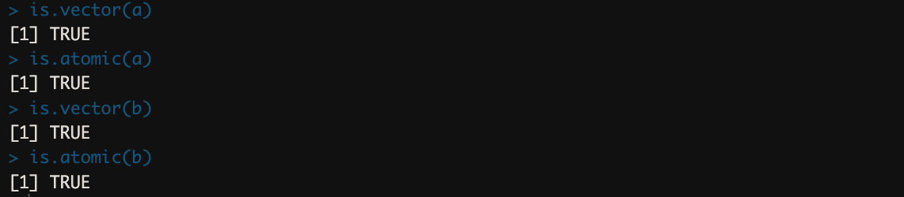
Vector

Slide 38
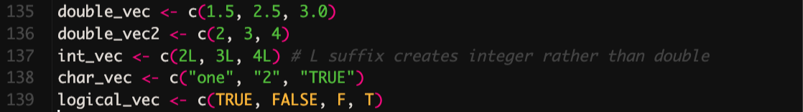
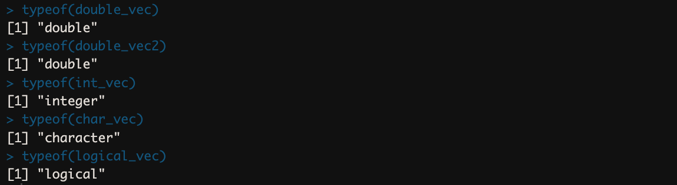
Vector
Vectors (atomic vectors) are usually created with C():

Slide 39
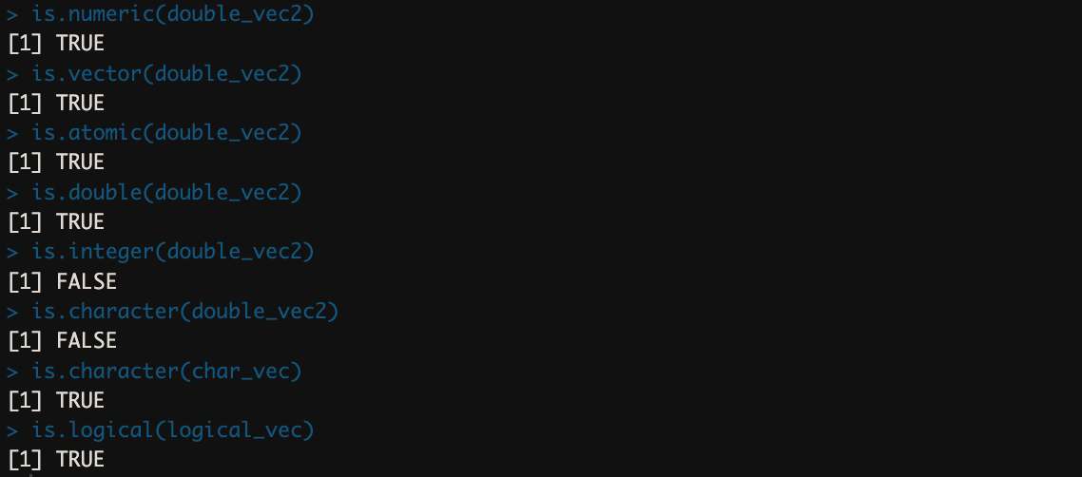
Vector

Slide 40
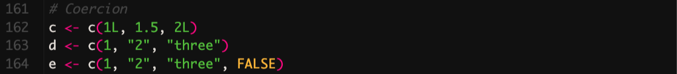
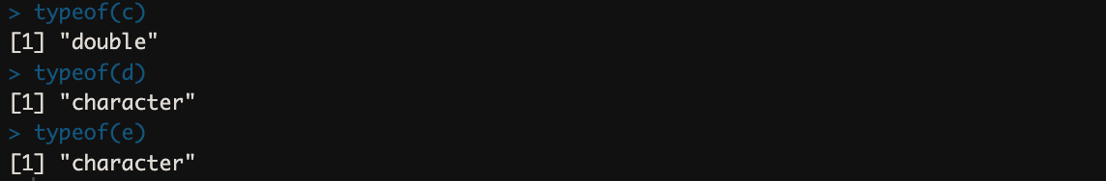
Vector
Coercion
Atomic vector only can accept values of one type; thus, if there are various values it coerce them to become one type.

Slide 41
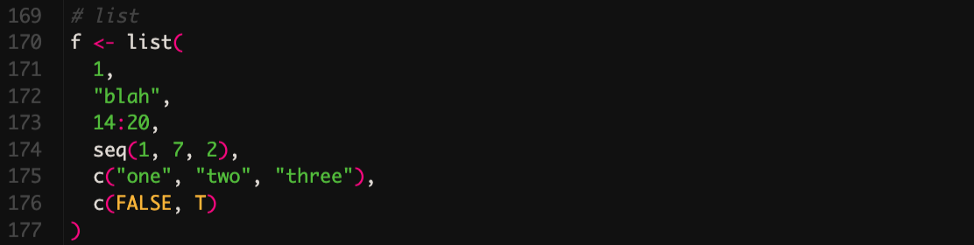
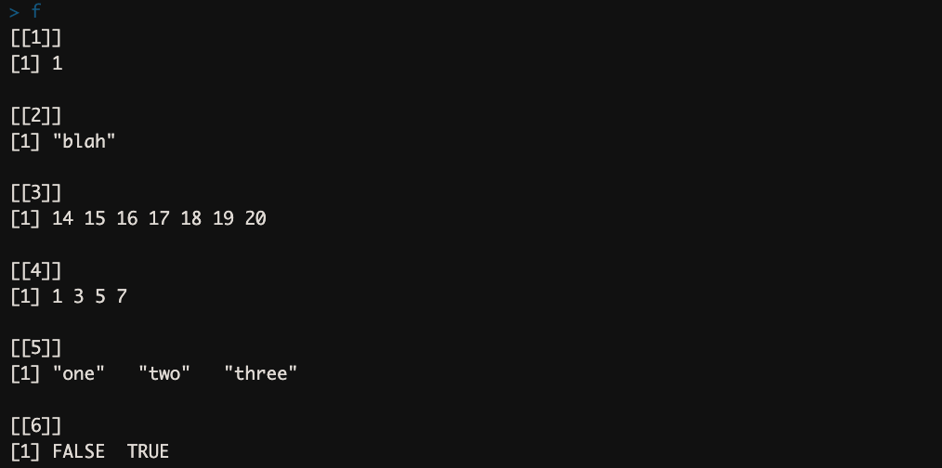
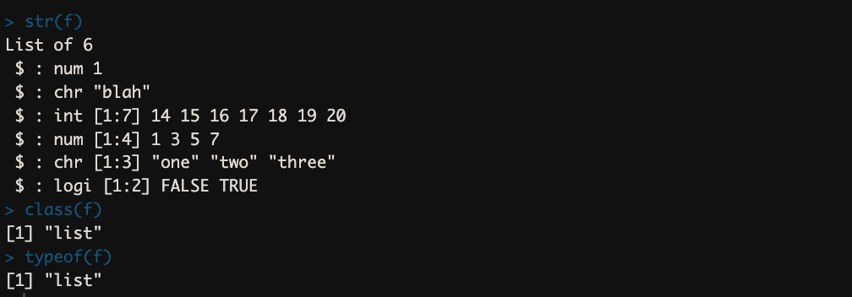
List
Lists could be constructed using list() function:

Slide 42
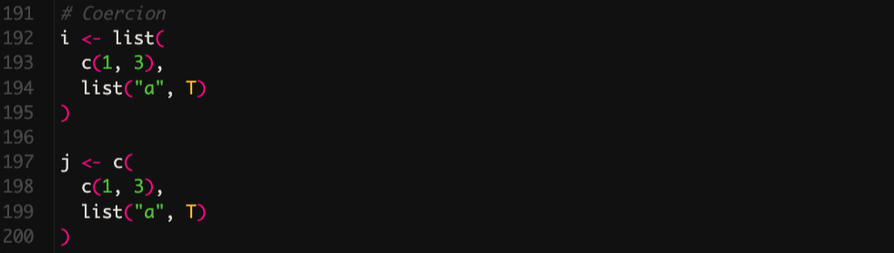
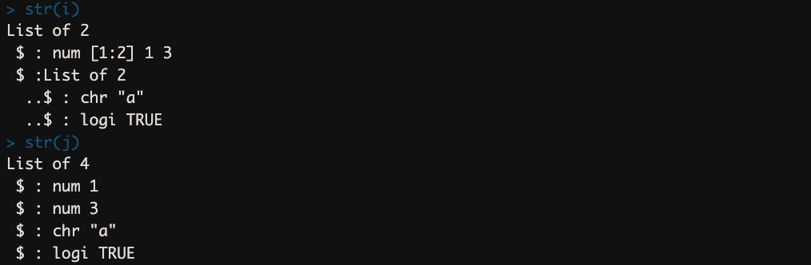
Recursive lists and Coercion

Slide 43
Matrix and Array
Arrays are formed when dimensions are added to a vector
Matrices are a specific type of arrays with only two dimensions
Arrays and matrices could be defined using, array() and matrix() functions, respectively.

Slide 44
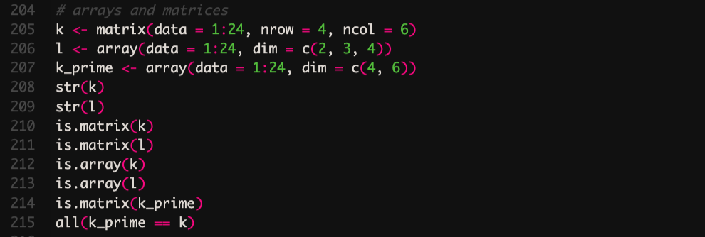
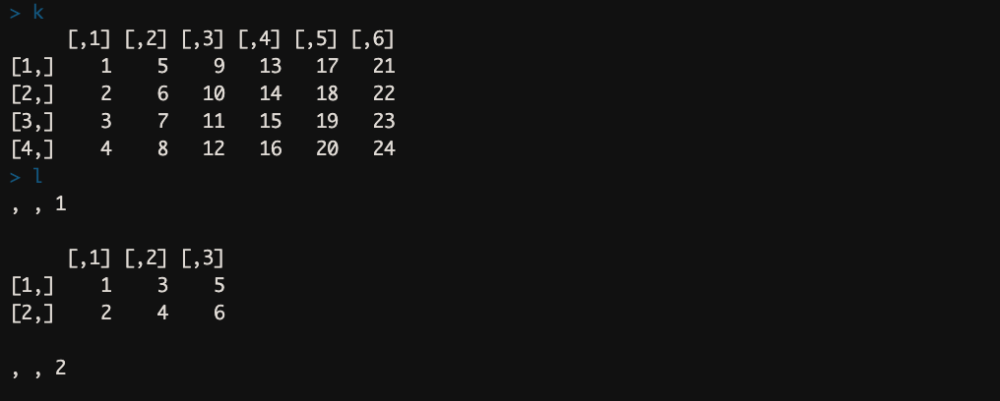
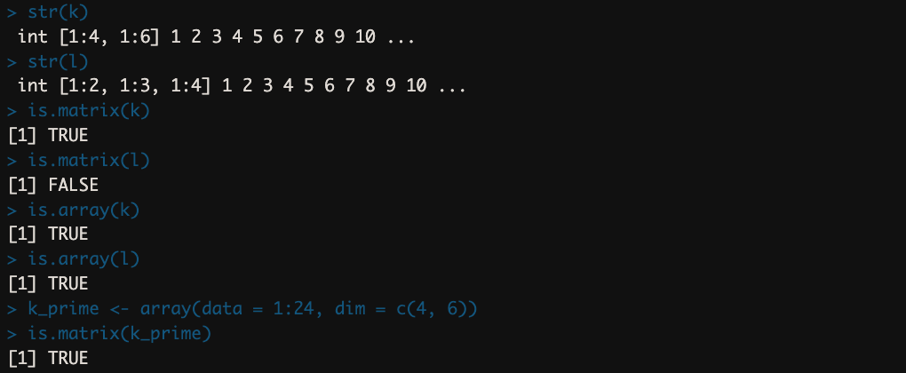
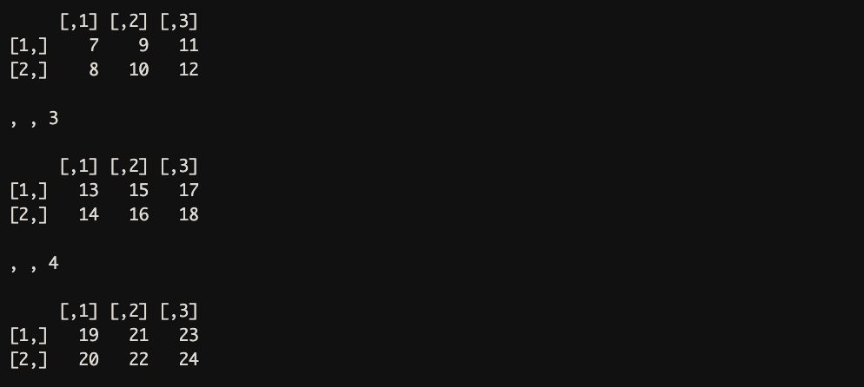
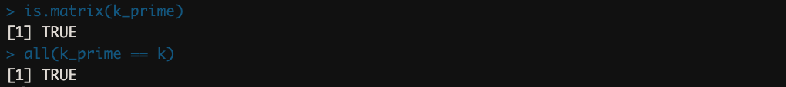
Matrix and Array

Slide 45
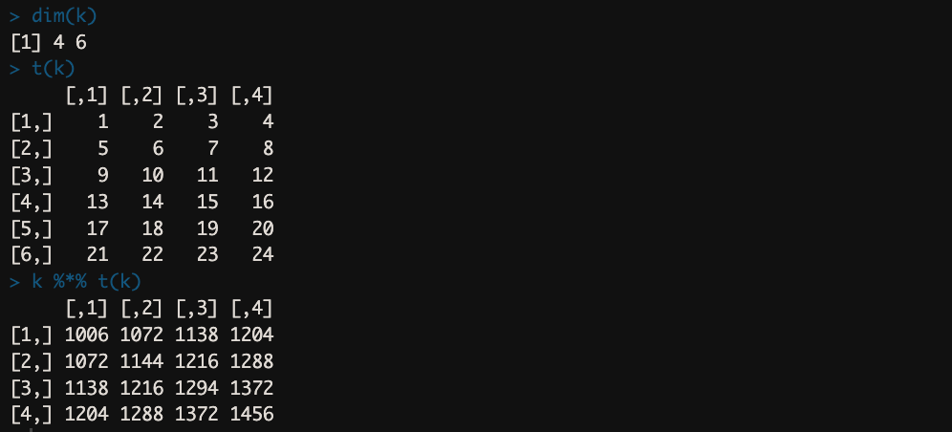
Matrix and Array
%*% could be used for matrix multiplication
t() function is used to transpose the matrix
dim() gives the dimensions of the matrix

Slide 46
Data Frame

Slide 47
Data Frame
The most common and important method for storing data in R
It has a 2D structure
Generally it is a list of vectors with identical structure
Data frame is created using data.frame() function
Data frame items could be accessed through the following indices:
df[row number, column number]
df[row number, column name]
df$column name[row number]

Slide 48
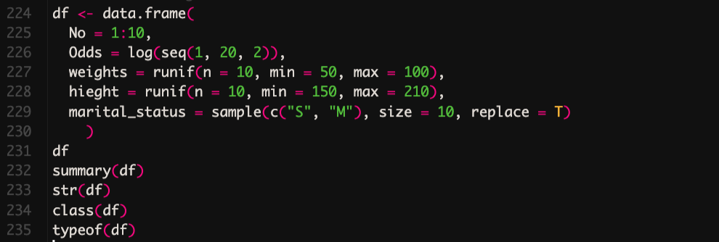
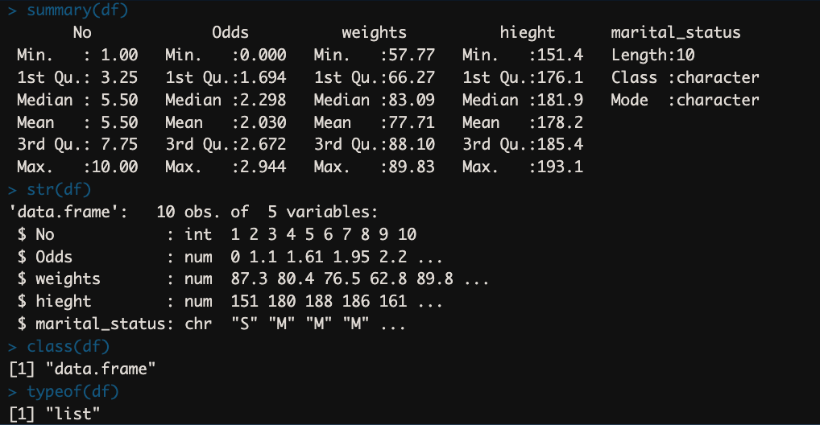
Example
Data Frame

Slide 49
Installing Packages
From CRAN
install.packages(“package name”)
From github
install.packages(“devtools”)
devtools::install_github(“package name”)
Library(package name) or require(package name) are used to load package
Library() to check all installed packages and sessionInfo() to check all loaded packages
citation() to get reference for specific package

Slide 50
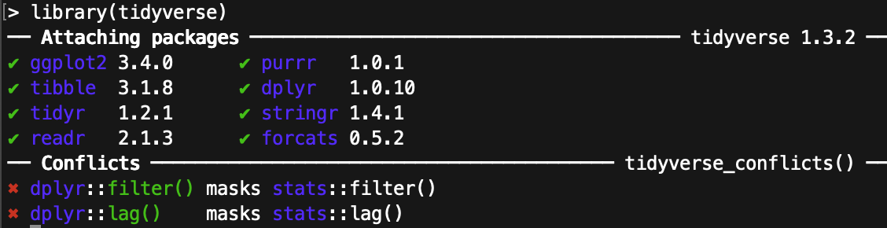
dplyr and tidyverse packages
install.packages(“dplyr”)
library(dplyr)
Or to have all needed basic packages
install.packages(“tidyverse”)
library(tidyverse)

Slide 51
Read and write CSV
setwd() is used to set the default directory to what we are going to work with
getwd() is used to get the current working directory
readr::read_csv(“file path”)
readr::write_csv(x = data, file = “file path”)

Slide 52
Filter, Select, Subset
filter() is used to apply conditionals on rows of a column
select() is used to select or remove a specific column
subset() function can do both jobs at the same time

Slide 53
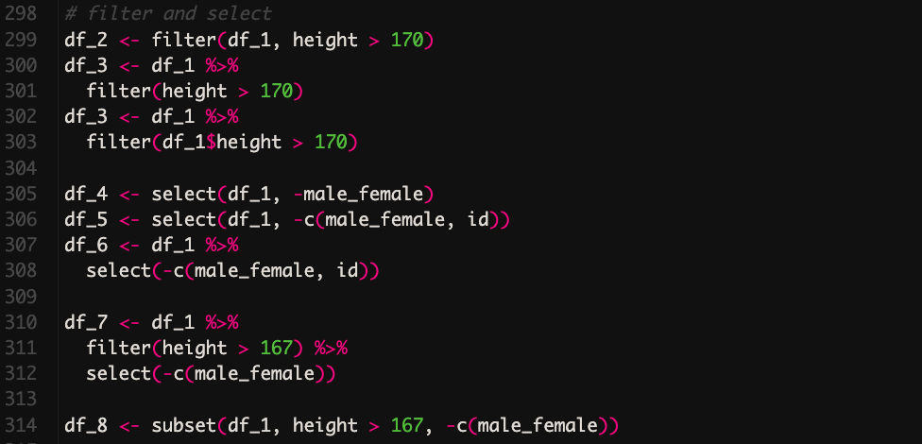
Example
Filter, Select, and Subset

Slide 54
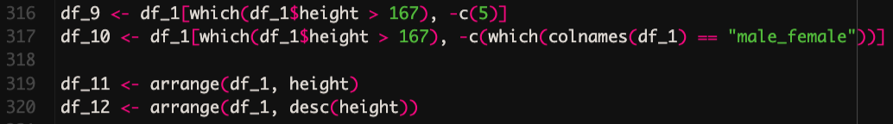
Example
Subseting without using functions

Slide 55

Mutate and Transmute
mutate() is used to change an existing column in a data frame
transmute() is used to define a new column in a data frame

Slide 56

Factor
Factors are used to categorize data. Examples of factors are:
Demography: Male/Female
Music: Rock, Pop, Classic, Jazz
Training: Strength, Stamina

Slide 57
03
Basics of Statistics with R

Slide 58
Mean, Median, Mode
The mean is useful for understanding the central tendency of a data set.
The median is useful for understanding the typical value in a data set and is less sensitive to extreme values than the mean.
The mode is useful for understanding the most common value in a data set and can be helpful in identifying patterns or trends.

Slide 59



Example
Mean, Mode, and Median

Slide 60
Some other useful functions to check and describe data
min() and max()
sd()
IQR()
range()
length()
unique()
quantile()
summary()
Hmisc::describe()
psych::describe()
table()
table.prop()
distinct()
gather()

Slide 61

Group_by
To provide summary statistics based on different groups of a variable existing in a database

Slide 62




ggplot2
Grammar of Graphics

Slide 63


Example
ggplot

Slide 64


Example
ggplot

Slide 65


Example
ggplot

Slide 66





Example
simple plots

Slide 67
04
Inferential Statistics with R

Slide 68
Assess for Normality
Histogram
Q-Q plot
Shapiro-Wilk test → small sample size < 50
Kolmogorov-Smirnov → larger sample size
Anderson-Darling test → variation of K-S test, optimized for small sample size and is more powerful than S-W

Slide 69


Example
Histogram
Histogram with normal distribution line
Q-Q plot

Slide 70



Example
S-W test
K-S test
A-D test

Slide 71

T-test

Slide 72

Mann-Whitney U Test

Slide 73



Correlation

Slide 74


Chi-Square

Slide 75
RESOURCES
Codecademy Learn R
The cartoon guide to statistics, Larry Gonick
Discovering Statistics Using R, Andy Field
Medical Statistics Made Easy, Gordon Taylor and Michael Harris
Understanding Clinical Research: Behind the Statistics, University of Cape Town
Learning R, The Hard Way Slides, Maani Beigy
W3schools, R

Slide 76
THANKS!
Do you have any questions?
alirezasoltanykhaboushan@gmail.com
+98-9157707497
https://www.linkedin.com/in/alireza-soltani-709848255/
@medicosine

